Slide 1
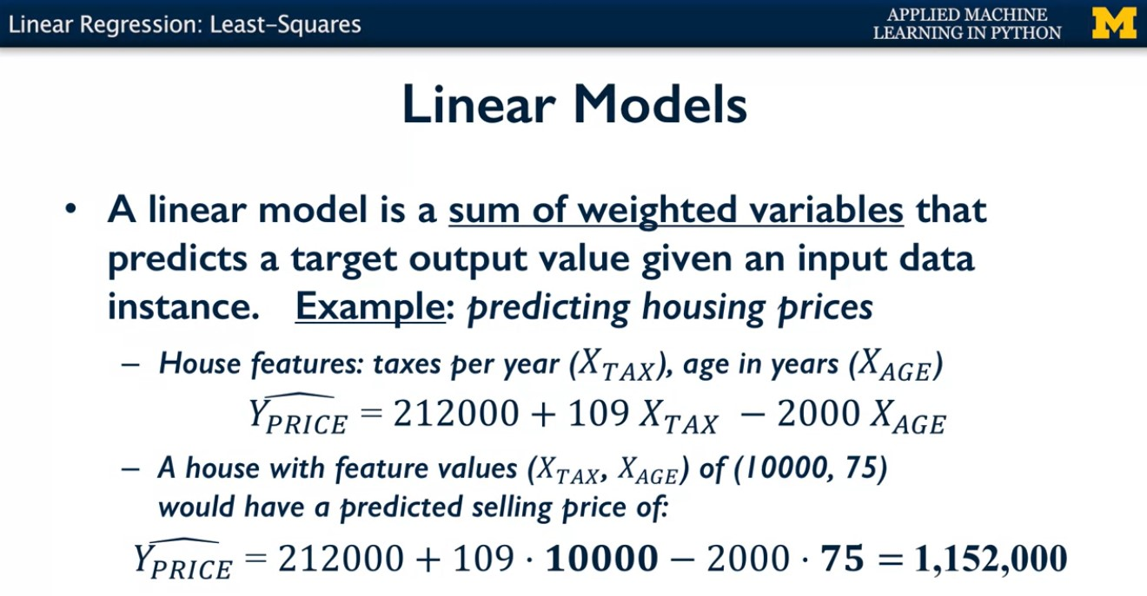
For example, our goal may be to predict the market value of a house, its expected sales price in the next month, for example. Suppose we're given two input variables, how much tax the properties assessed each year by the local government, and the age of the house in years. You can imagine that these two features of the house would each have some information that's helpful in predicting the market price. Because in most places, there's a positive correlation between the tax assessment on a house and its market value.
Indeed the tax assessment is often partly based on market prices from previous years. And may be a negative correlation between its age in years and the market value, so older houses may need more repairs and upgrading, for example.
One linear model, which I have made up as an example, could compute the expected market price in US dollars by starting with a constant term, here 212,000. And then adding some number, let's say 109 times the value of tax paid last year, and then subtracting 2,000 times the age of the house in years. So for example this linear model would estimate the market price of a house where the taxes estimate was $10,000 and that was 75 years old as about $1.2 million. Now I just made up this particular linear model myself as an example but in general when we talk about training a linear model. We mean estimating values for the parameters of the model, or coefficients of the model as we sometimes call them, which are here the constant value 212,000 and the weights 109 and 20. In such a way that the resulting predictions for the outcome variable Yprice, for different houses are a good fit to the data from actual past sales. We'll discuss what good fit means shortly. Predicting house price is an example of a regression task using a linear model called, not surprisingly, linear regression.

Slide 2
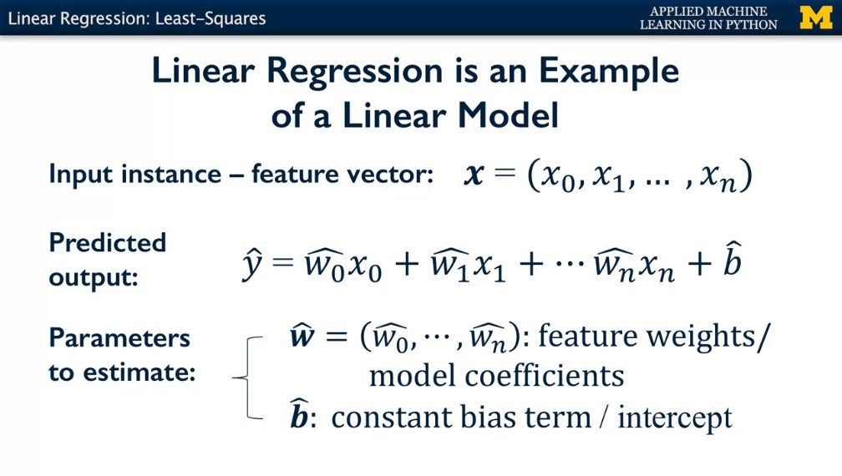
Each feature, xi, has a corresponding weight, wi. The predicted output, which we denote y hat, is a weighted sum of features plus a constant term b hat. I've put a hat over all the quantities here that are estimated during the regression training process. The w hat and b hat values which we call the train parameters or coefficients are estimated from training data. And y hat is estimated from the linear function of input feature values and the train parameters.
For example, in the simple housing price example we just saw, w0 hat was 109, x0 represented tax paid, w1 hat was negative 20 x1 was house age and b hat was 212,000. We called these wi values model coefficients or sometimes future weights, and b hat is called the bias term or the intercept of the model.

Slide 3
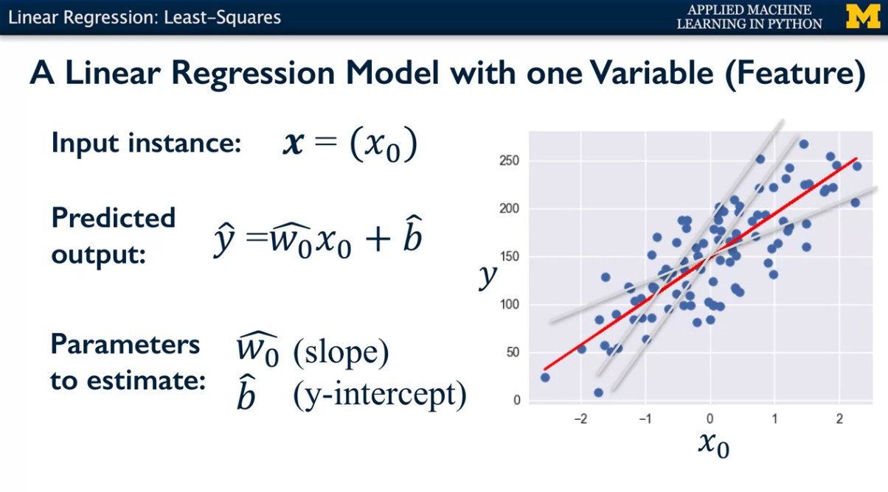
b (y intercept)
Wo
Here's an example of a linear regression model with just one input variable or feature x0 on a simple artificial example dataset. The blue cloud of points represents a training set of x0, y pairs. In this case, the formula for predicting the output y hat is just w0 hat times x0 + b hat, which you might recognize as the familiar slope intercept formula for a straight line, where w0 hat is the slope, and b hat is the y intercept. The grand red lines represent different possible linear regression models that could attempt to explain the relationship between x0 and y. You can see that some lines are a better fit than others. The better fitting models capture the approximately linear relationship where as x0 increases, y also increases in a linear fashion. The red line seemed specially good. Intuitively, there are not as many blue training points that are very far above or very far below the red linear model prediction. Now the important thing to remember is that there's a training phase and a prediction phase. So the training phase, using the training data, is what we'll use to estimate w0 and b.

Slide 4
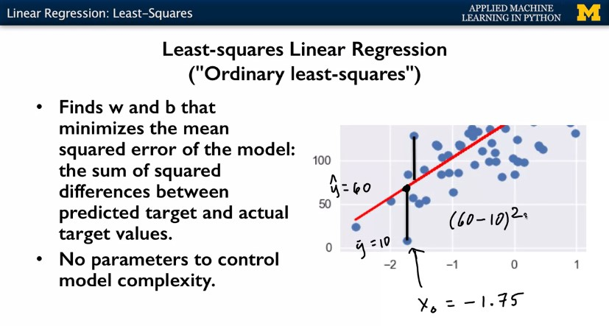
So widely used method for estimating w and b for linear aggression problems is called least-squares linear regression, also known as ordinary least-squares. Least squares linear regression finds the line through this cloud of points that minimizes what is called the means squared error of the model. The mean squared error of the model is essentially the sum of the squared differences between the predicted target value and the actual target value for all the points in the training set.
This plot illustrates what that means. The blue points represent points in the training set, the red line here represents the least-squares models that was found through these cloud of training points. And these black lines show the difference between the y value that was predicted for training point based on it's x position, and the actual y value of the training point. So for example here, this point let's say has an x value of- 1.75. And if we plug it into the formula for this linear model, we get a prediction here, at this point on the line, which is somewhere around let's say 60. But the actual observed value in the training set for this point was maybe closer to 10. So, in this case, for this particular point, the squared difference between the predicted target and the actual target would be (60- 10) squared. So, we can do this calculation for every one of the points in the training set. We can compute this squared difference between the y value we observe in the training set for a point, and the y value that would be predicted by the linear model, given that training points x value. So each of these can be computed as the square difference can be computed, and then if we add all these up, And divide by the number of training points, take the average, that will be the mean squared error of the model. So the technique of least-squares, is designed to find the slope, the w value, and the b value of the y intercept, that minimize this squared error, this mean squared error. One thing to note about this linear regression model is that there are no parameters to control the model complexity. No matter what the value of w and b, the result is always going to be a straight line. This is both a strength and a weakness of the model as we'll see later. When you have a moment, compare this simple linear model to the more complex regression model learned with K nearest neighbors regression on the same dataset. You can see that linear models make a strong prior assumption about the relationship between the input x and output y. Linear models may seem simplistic, but for data with many features linear models can be very effective and generalize well to new data beyond the training set.

Slide 5
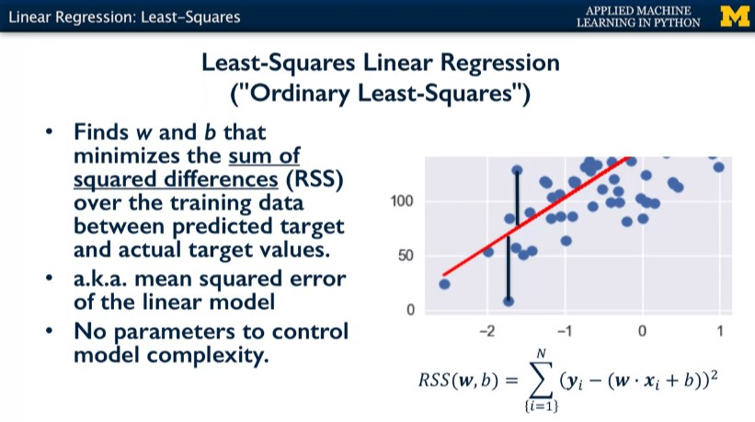
The most popular way to estimate w and b parameters is using what's called least-squares linear regression or ordinary least-squares. Least-squares finds the values of w and b that minimize the total sum of squared differences between the predicted y value and the actual y value in the training set. Or equivalently it minimizes the mean squared error of the model. Least-squares is based on the squared loss function mentioned before. This is illustrated graphically here, where I've zoomed in on the left lower portion of this simple regression dataset. The red line represents the least-squares solution for w and b through the training data. And the vertical lines represent the difference between the actual y value of a training point, xi, y and it's predicted y value given xi which lies on the red line where x equals xi. Adding up all the squared values of these differences for all the training points gives the total squared error and this is what the least-square solution minimizes. Here, there are no parameters to control model complexity. The linear model always uses all of the input variables and always is represented by a straight line. Another name for this quantity is the residual sum of squares. The actual target value is given in yi and the predicted y hat value for the same training example is given by the right side of the formula using the linear model with that parameters w and b

Slide 6
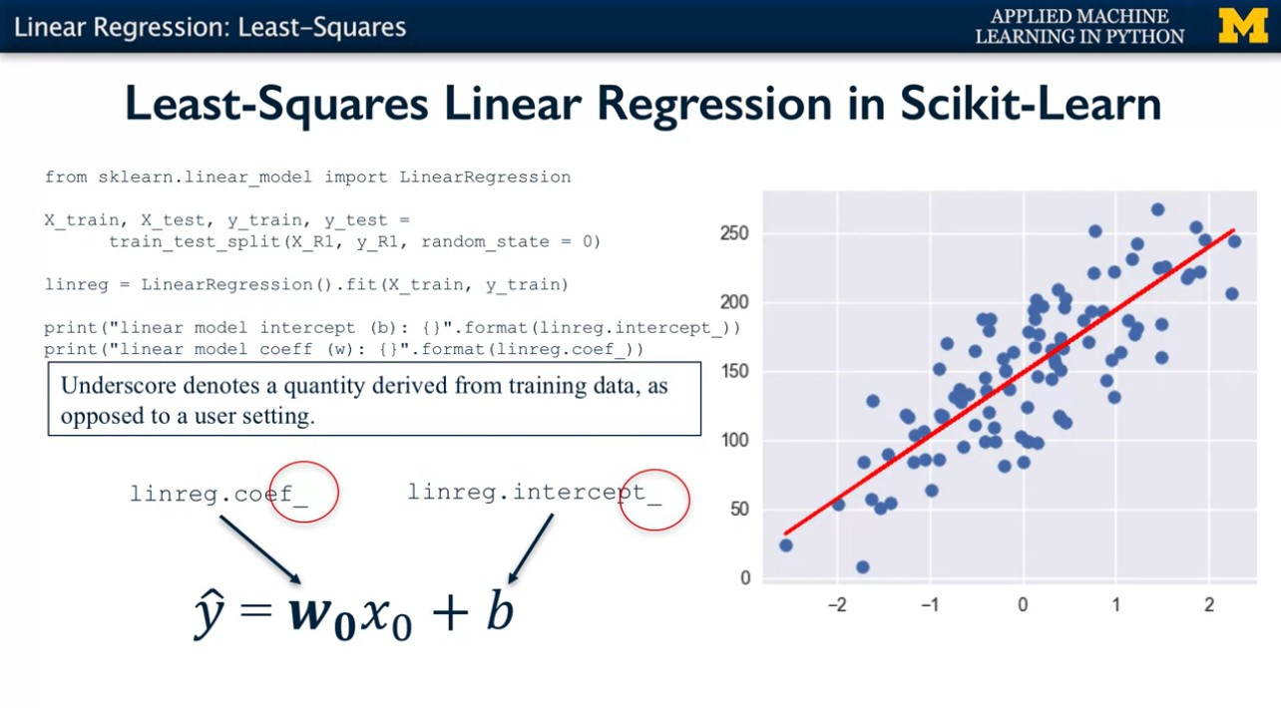
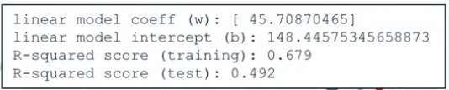

Slide 7
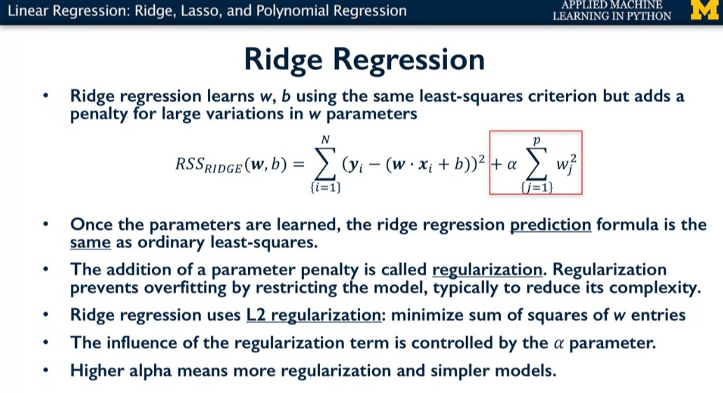

Slide 8
Description of previous slide (Linear model : Ridge Regression)
Now we'll look at another way to estimate W and B for linear model, called Ridge Regression. Ridge regression uses the same least-squares criterion, but with one difference. During the training phase, it adds a penalty for feature weights, the WI values that are too large as shown in the equation here. You'll see that large weights means mathematically that the sum of their squared values is large. Once ridge regression has estimated the WNB parameters for the linear model, the prediction of Y values for new instances is exactly the same as in least squares. You just plug in your input feature values, the XIs and compute the sum of the weighted feature values plus B with the usual in your formula. So why would something like ridge regression be useful?
This addition of a penalty term to a learning algorithm's objective function is called Regularisation. Regularisation is an extremely important concept in machine learning. It's a way to prevent overfitting, and thus, improve the likely generalization performance of a model, by restricting the models possible parameter settings. Usually the effect of this restriction from regularisation, is to reduce the complexity of the final estimated model. So how does this work with linear regression? The addition of the sum of squared parameter values that's shown in the box, to the least-squares objective means that models with larger feature weights (w) add more to the objective functions overall value. Because our goal is to minimize the overall objective function, the regularisation term acts as a penalty of models with lots of large feature weight values.
In other words, all things being equal, if ridge regression finds two possible linear models that predict the training data values equally well, it will prefer the linear model that has a smaller overall sum of squared feature weights. The practical effect of using ridge regression, is to find the feature weights WI that fit the data well in at least square sense, and that set lots of the feature weights two values that are very small. We don't see this effect with a single variable linear regression example, but for regression problems with dozens or hundreds of features, the accuracy improvement from using regularized linear regression like ridge regression could be significant. The amount of regularisation to apply is controlled by the alpha parameter. Larger alpha means more regularization and simpler linear models with weights closer to zero. The default setting for alpha is 1.0. Notice that setting alpha to zero corresponds to the special case of ordinary least-squares linear regression that we saw earlier, that minimizes the total square here.

Slide 9
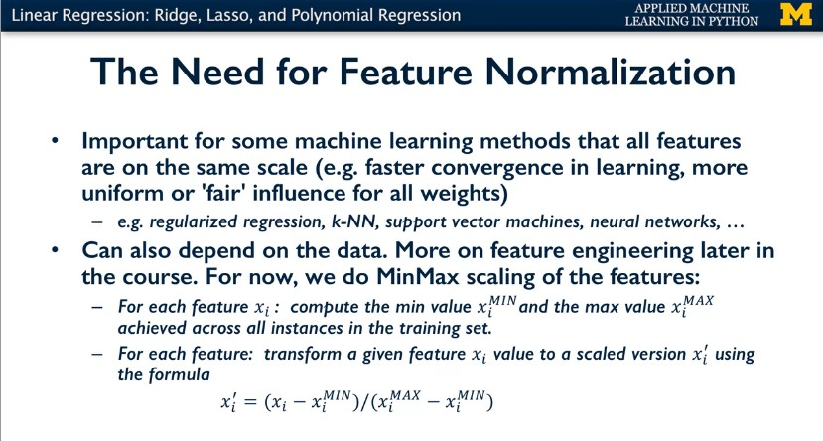

Slide 10
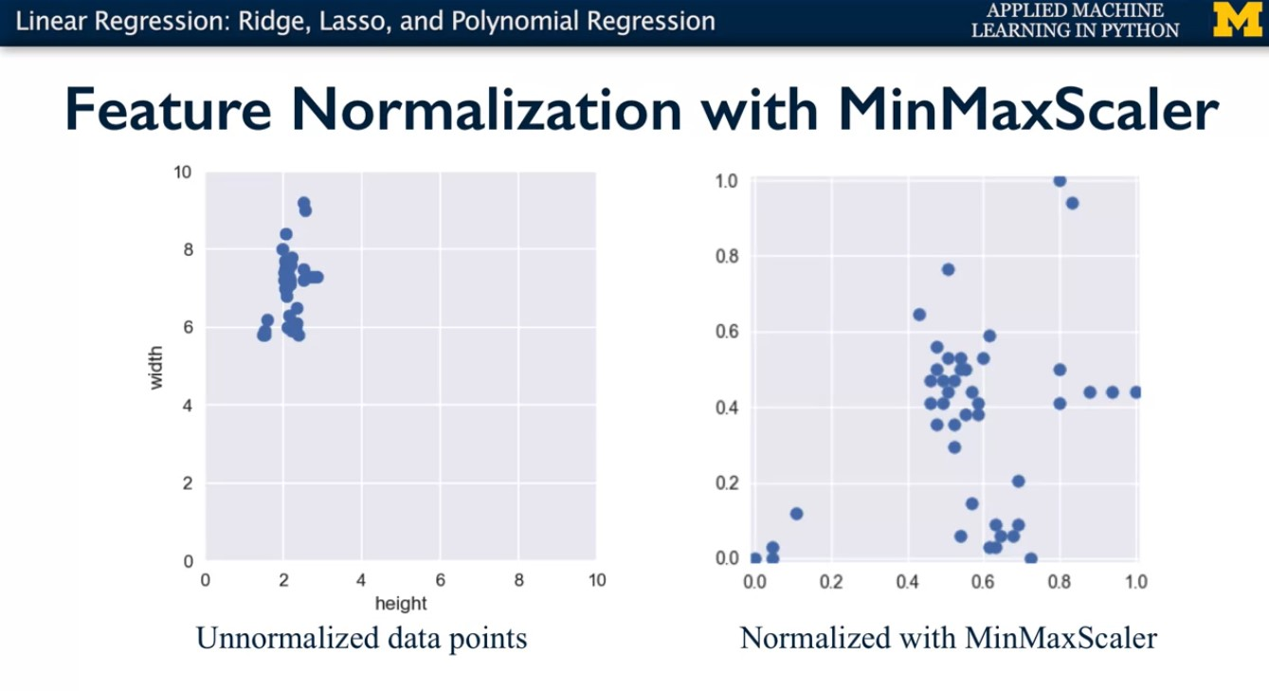
Here's an example of how it works with two features. Suppose we have one feature "height" whose values fall in a fairly narrow range between 1.5 and 2.5 units.
But a second feature, "width" has a much wider range between five and 10 units.
After applying minmax scaling, values for both features are transformed because they are on the same scale, with the minimum value getting mapped to zero, and the maximum value being transformed to one. And everything else getting transformed to a value between those two extremes.

Slide 11
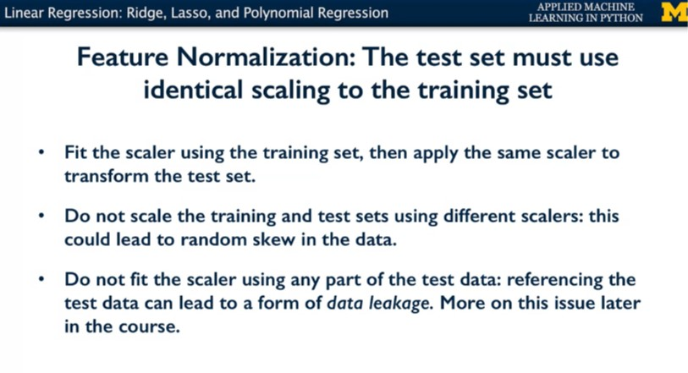
You may have noticed two things here. First, that we're applying the same scalar object to both the training and the testing. And second, that we're training the scalar object on the training data and not on the test data. These are both critical aspects to feature normalization. If you don't apply the same scaling to training and test sets, you'll end up with more or less random data skew, which will invalidate your results. If you prepare the scaler or other normalization method by showing it the test data instead of the training data, this leads to a phenomenon called Data Leakage, where the training phase has information that is leaked from the test set. For example, like the distribution of extreme values for each feature in the test data, which the learner should never have access to during training. This in turn can cause the learning method to give unrealistically good estimates on the same test set. We'll look more at the phenomenon of data leakage later in the course. One downside to performing feature normalization is that the resulting model and the transformed features may be harder to interpret. Again, in the end, the type of feature normalization that's best to apply, can depend on the data set, learning task and learning algorithm to be used. We'll continue to touch on this issue throughout the course.

Slide 12
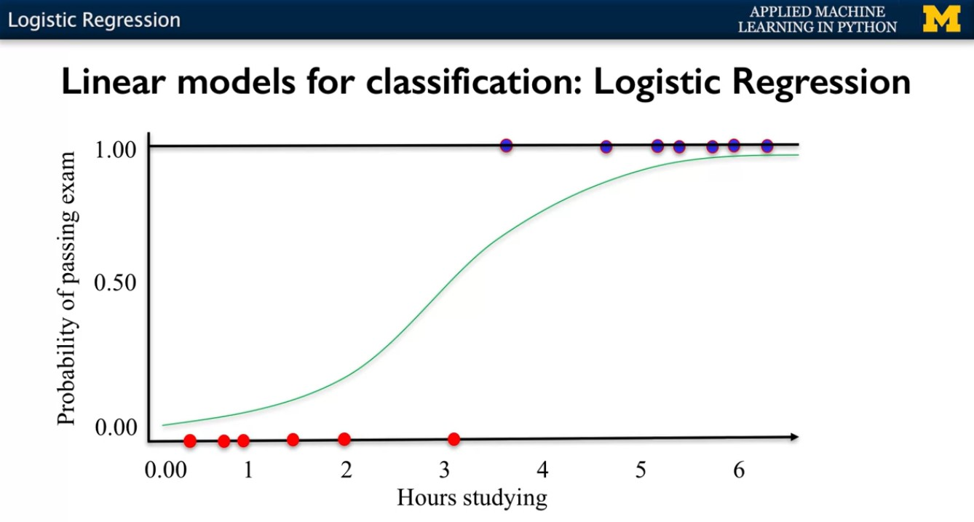
Let's look at a specific example of logistic regression with one input variable.
Suppose we want to whether or not a student will pass a final exam based on a single input variable that's the number of hours they spend studying for the exam. Students who end up failing the exam are assigned to the negative class, which corresponds to a target value of 0.
And students who pass the exam are assigned to the positive class and associated with a target value of 1.
This plot shows an example training set. The x-axis corresponds to the number of hours studied and the y-axis corresponds to the probability of passing the exam. The red points to the left, with a target value of 0 represent points in the training set, which are examples of students who failed the exam, along with the number of hours they spent studying.
Likewise, the blue points with target value 1 on the right represent points in the training set, corresponding to students who passed the exam. With their x values representing the number of hours those students spent studying. Using logistic regression, we can estimate model coefficients for w hat and b hat that produce a logistic curve that best fits these training points.
In this example that logistic curve might look something like this. Once the model coefficient has been estimated, we now have a formula that can use the result logistic function to estimate the probability that any given student will pass the exam, given the number of hours they've studied.
Students who estimated probability of passing the exam is greater than or equal to 50% are predicted to be in the positive class. Otherwise, they're predicted to be in the negative class. So in this example we can see that students who study for more than three hours will be predicted to be in the positive class.

Slide 13
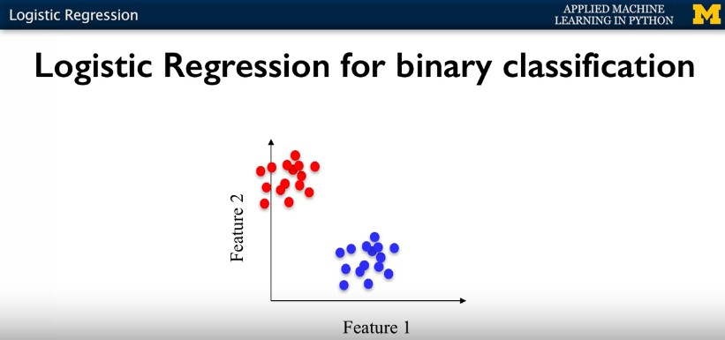
Let's look at an example that uses two input features now, instead of one. Here the plots show a training set with two classes. Each data point has two features.
Feature 1 corresponds to the x-axis, and Feature 2 corresponds to the y-axis. The data points in the red class on the left, form a cluster with low Feature 1 value, and high Feature 2 value. And the points in the blue class have intermediate Feature 1 value, and low Feature 2 value. We can apply logistic regression to learn a binary classifier using this training set, using the same idea we saw in the previous exam example.

Slide 14
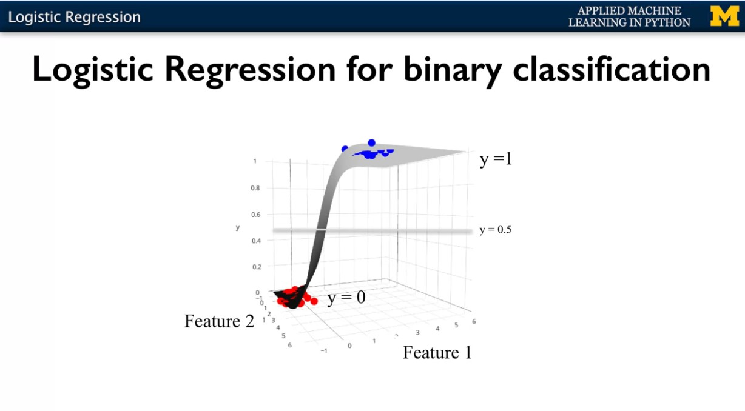
To do this, we'll add a third dimension shown here as the vertical y-axis. Corresponding to the probability of belonging to the positive class.
We'll say that the red points are associated with the negative class and have a target value of 0, and the blue points are associated with the positive class and have a target value of 1.
Then just as we did in the exam studying example, we can estimate the w hat and b hat parameters of the logistic function that best fits this training data. The only difference is that the logistic function is now a function of two input features and not just one. So it forms something like a three dimensional S shaped sheet in this space.
Once this logistic function has been estimated from the training data, we can use it to predict the class membership for any point, given its Feature 1 and Feature 2 values, same way we did for the exam example.
Any data instances whose logistic probability estimate y hat is greater than or equal to 0.5 are predicted to be in the positive blue class, otherwise, in the other red class.
Now if we imagine that there's a plane representing y equals 0.5, as shown here, that intersects this logistic function. It turns out that all the points that have a value of y = 0.5, when you intersect that with a logistic function, the points all lie along a straight line

